Slide 1
Getting Started with Dr Frost
A guide for students
September 2023

Slide 2




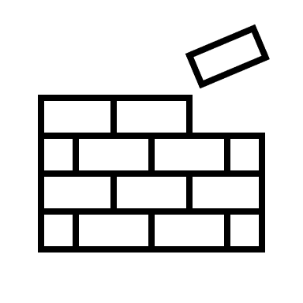
What is DrFrost?
An online classwork and homework platform
Designed to help you master mathematical Key Skills
Access video help at any time during a task
Earn points and trophies for achievements on Dr Frost
Practice topics independently to increase your mastery with each skill

Slide 3
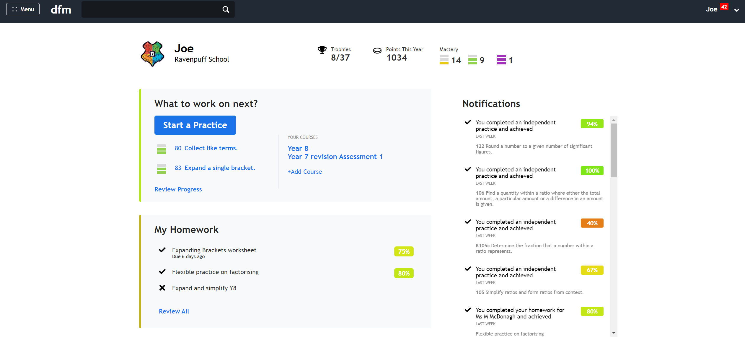
The home dashboard
You can see how many skills you have mastered at each level and your total points for the year.
You earn trophies for different achievements. For example, earning a certain number of points, or completing a certain number of questions correctly in a row.

Slide 4
Completing an assigned task
The red notification will tell you if you have homework and/or if you have feedback from your teacher.
Your most recent homework tasks appear on the dashboard. Click on the X to start.
Click ‘Review all’ to see every homework set to you this year.

Slide 5
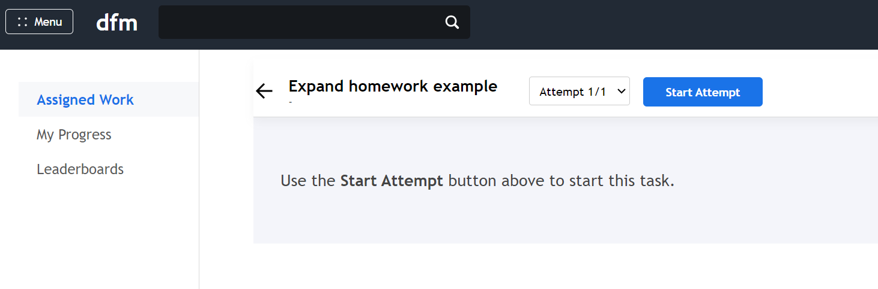
Completing an assigned task
To begin your homework press ‘Start Attempt’.

Slide 6
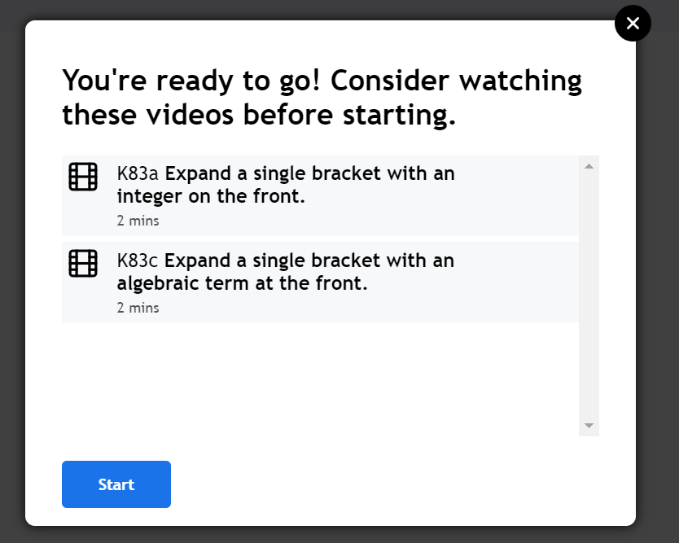
Completing an assigned task
You will get an option to watch videos relating to the skills in the task, you can watch these, or press ‘Start’ to skip this step.
Your teacher may require you to watch a video first, in which case, the ‘Start’ button will be greyed out until you’ve watched the full video.

Slide 7
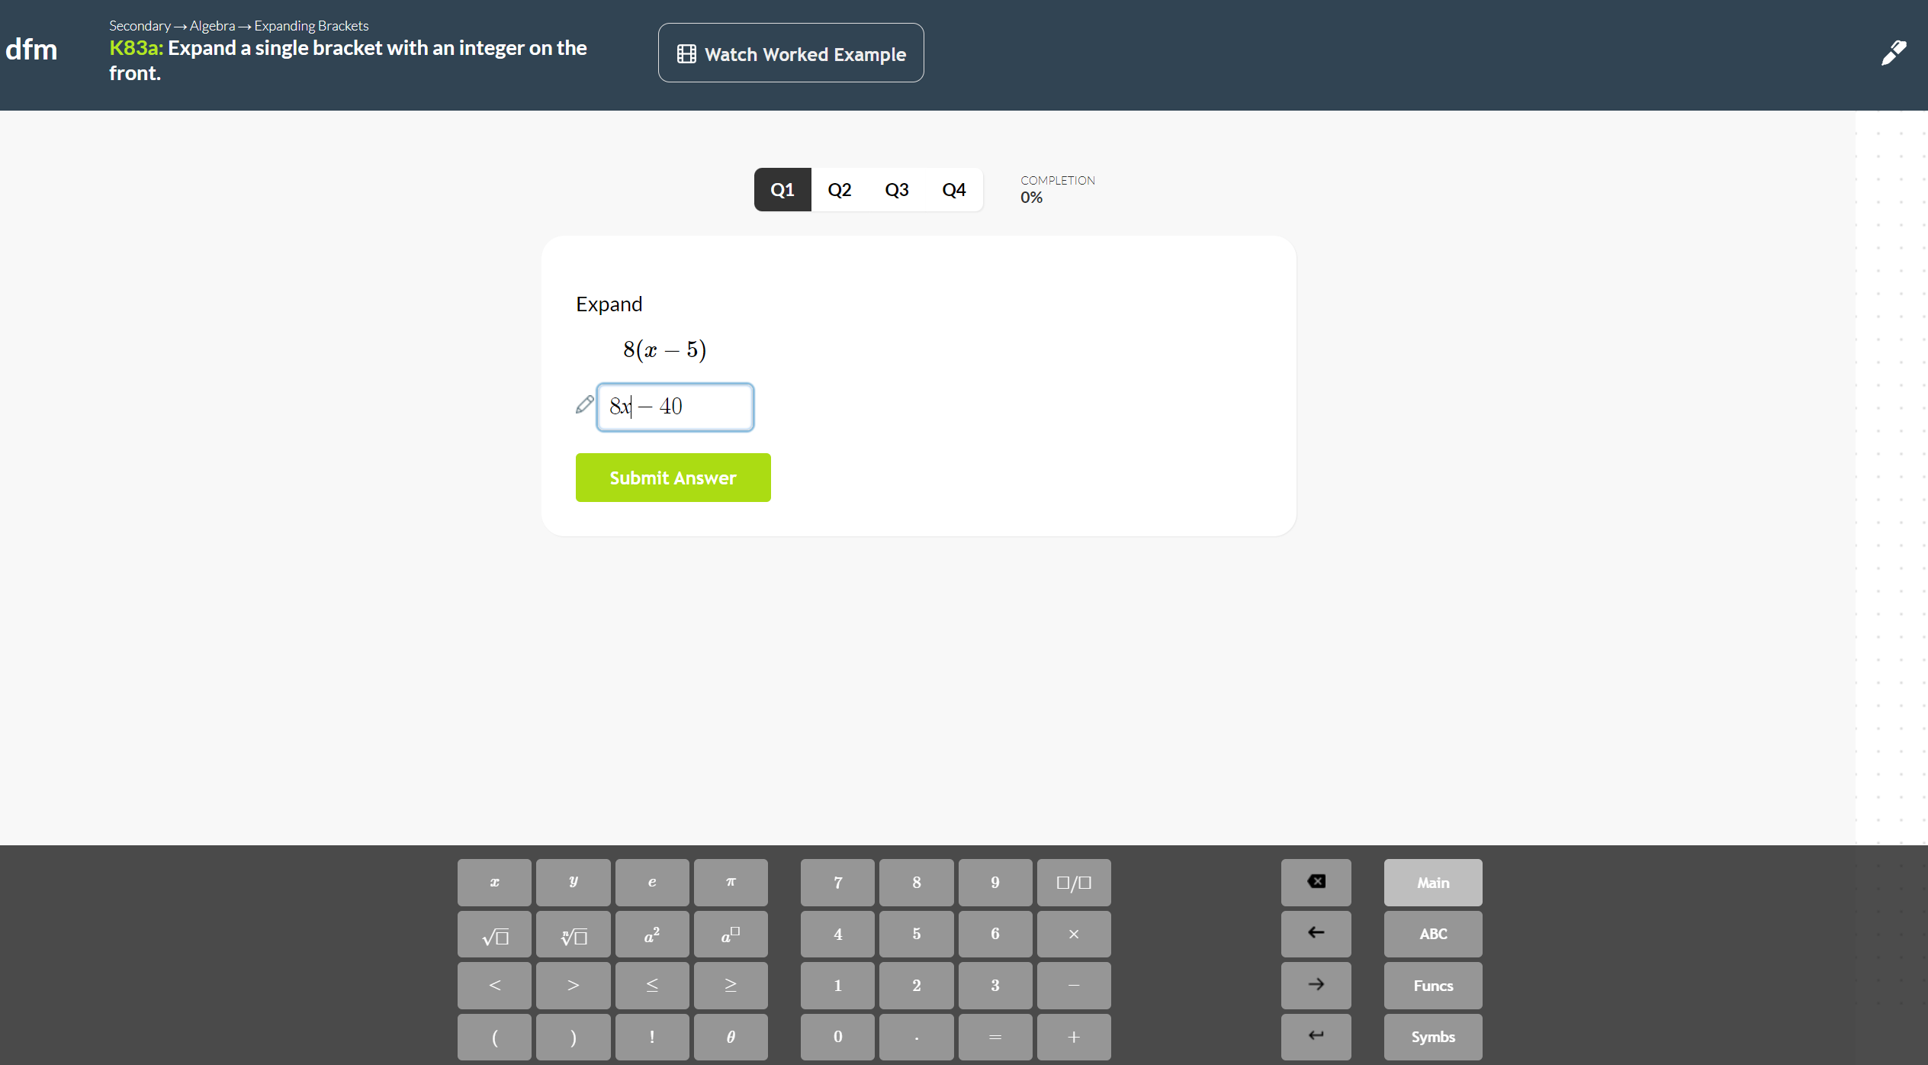
Completing an assigned task
Watch the help video if you’re stuck.
Type your answer in the box and use the keypad for mathematical symbols and functions.

Slide 8
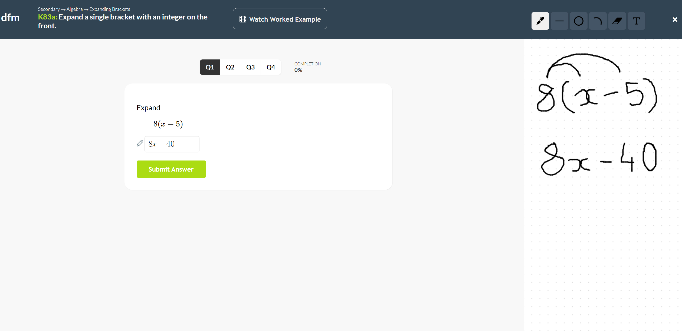
Completing an assigned task
Click the pen icon to show working on the side whiteboard.

Slide 9
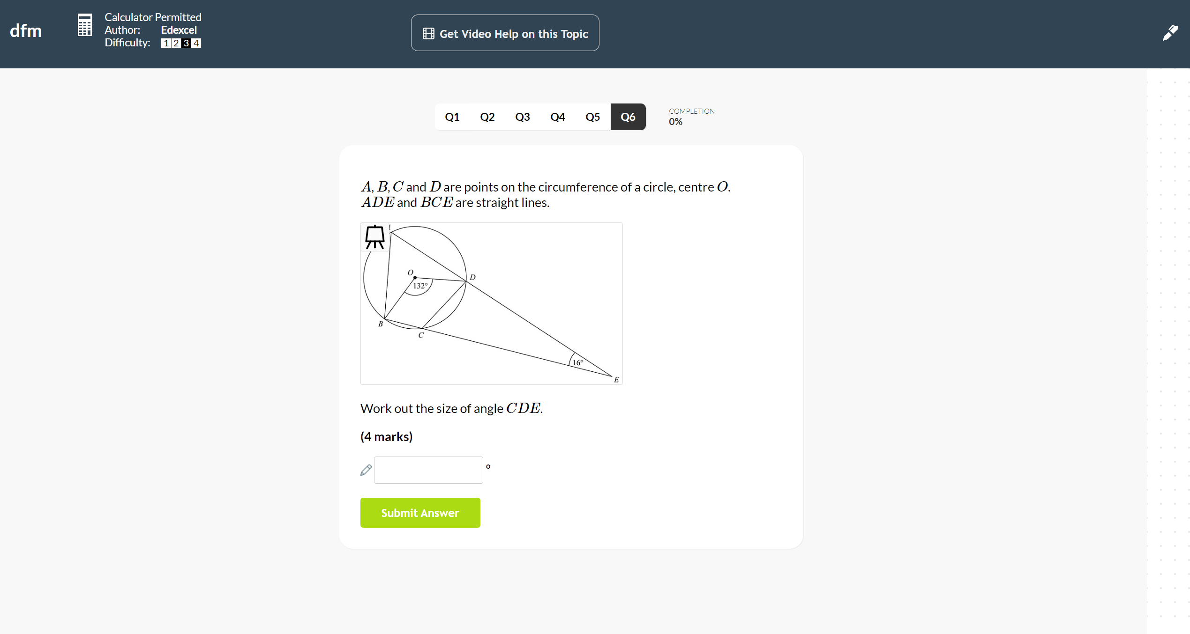
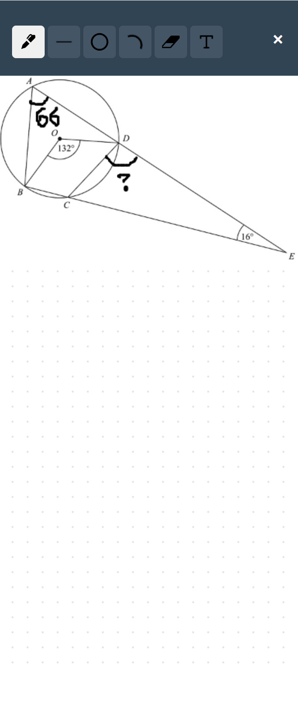
Completing an assigned task
If the question has a diagram, use your curser to hover over the image. If you click the easel icon the diagram will appear on the side whiteboard for you to annotate.

Slide 10
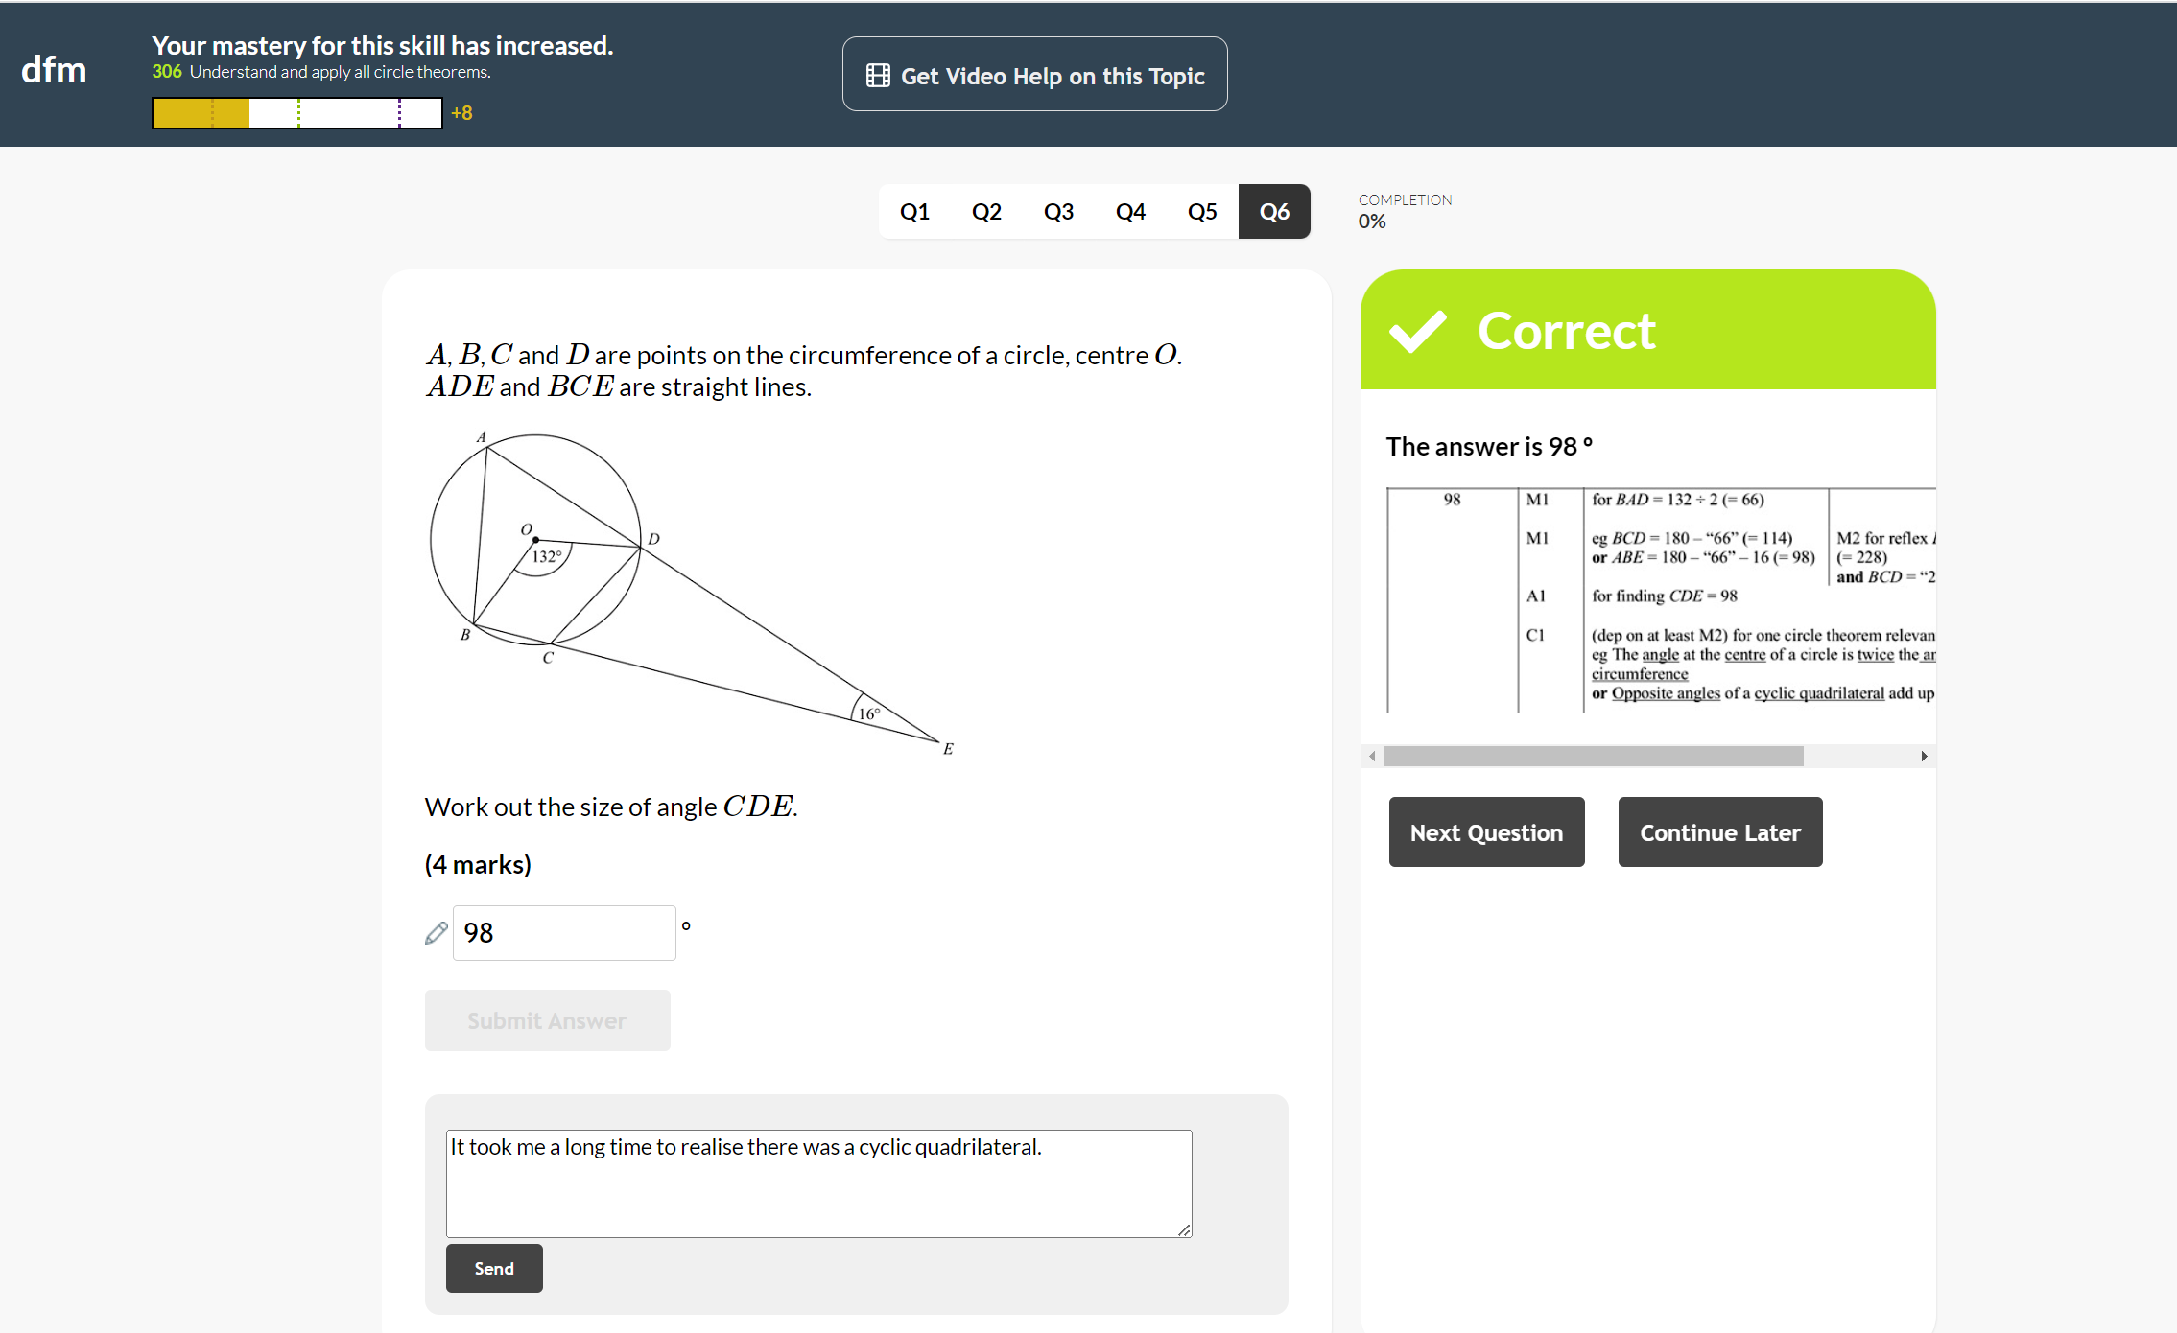
Completing an assigned task
Every question you answer impacts your mastery for that skill. It may go up, down or stay the same.
If the question you’ve answered is an exam question, you will be shown the mark scheme.
Write feedback to your teacher here.

Slide 11
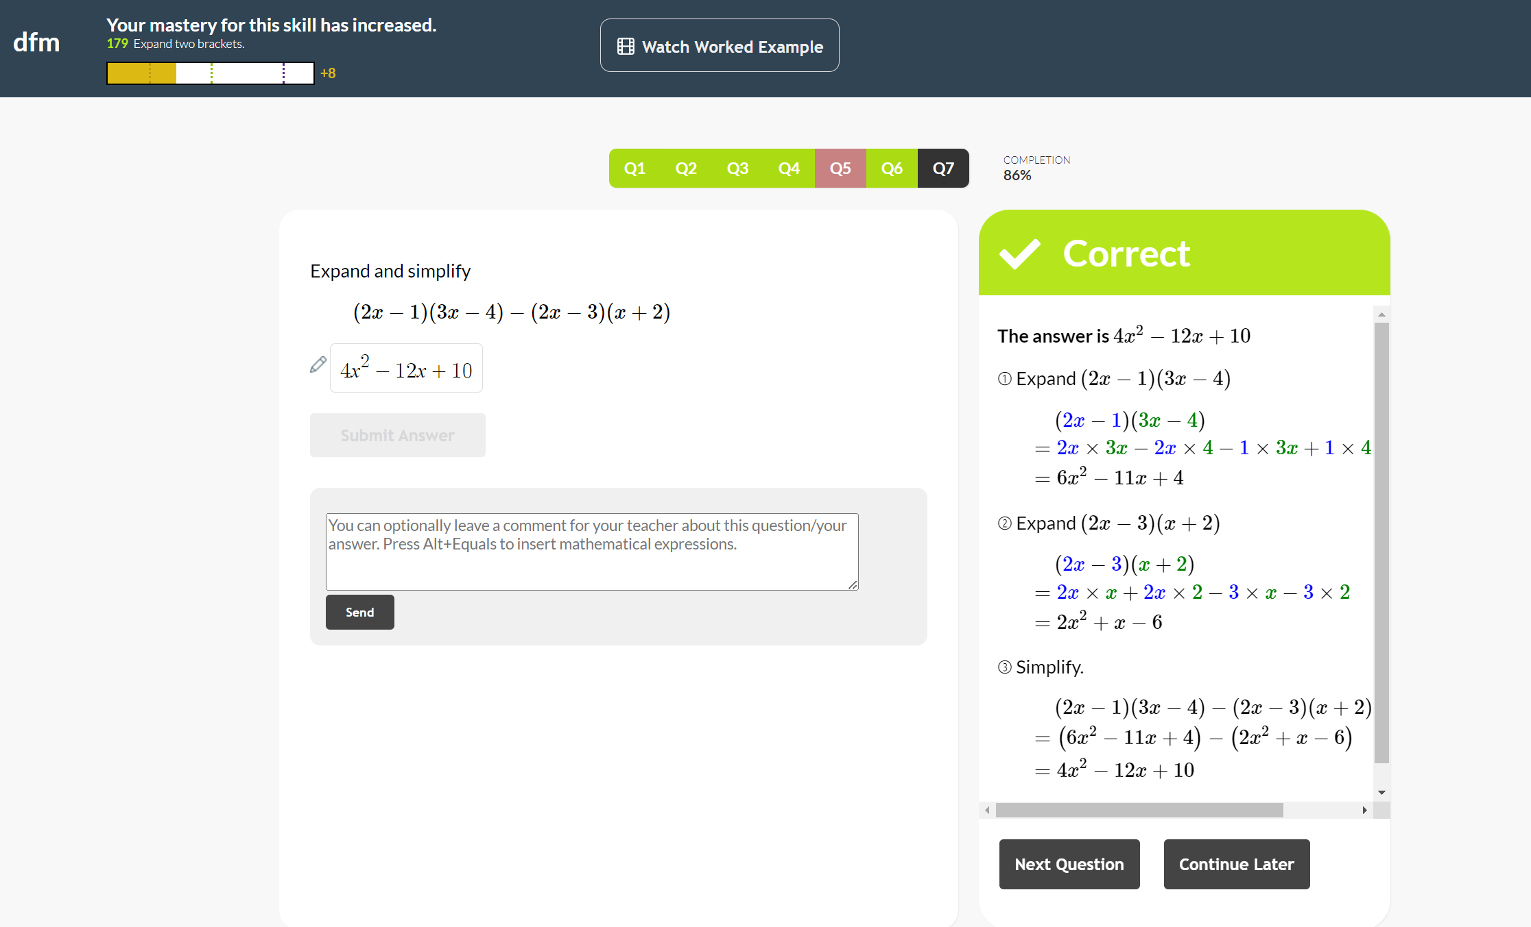
Completing an assigned task
If the question is a Key Skill question, you will be shown the full written method in the solution.

Slide 12
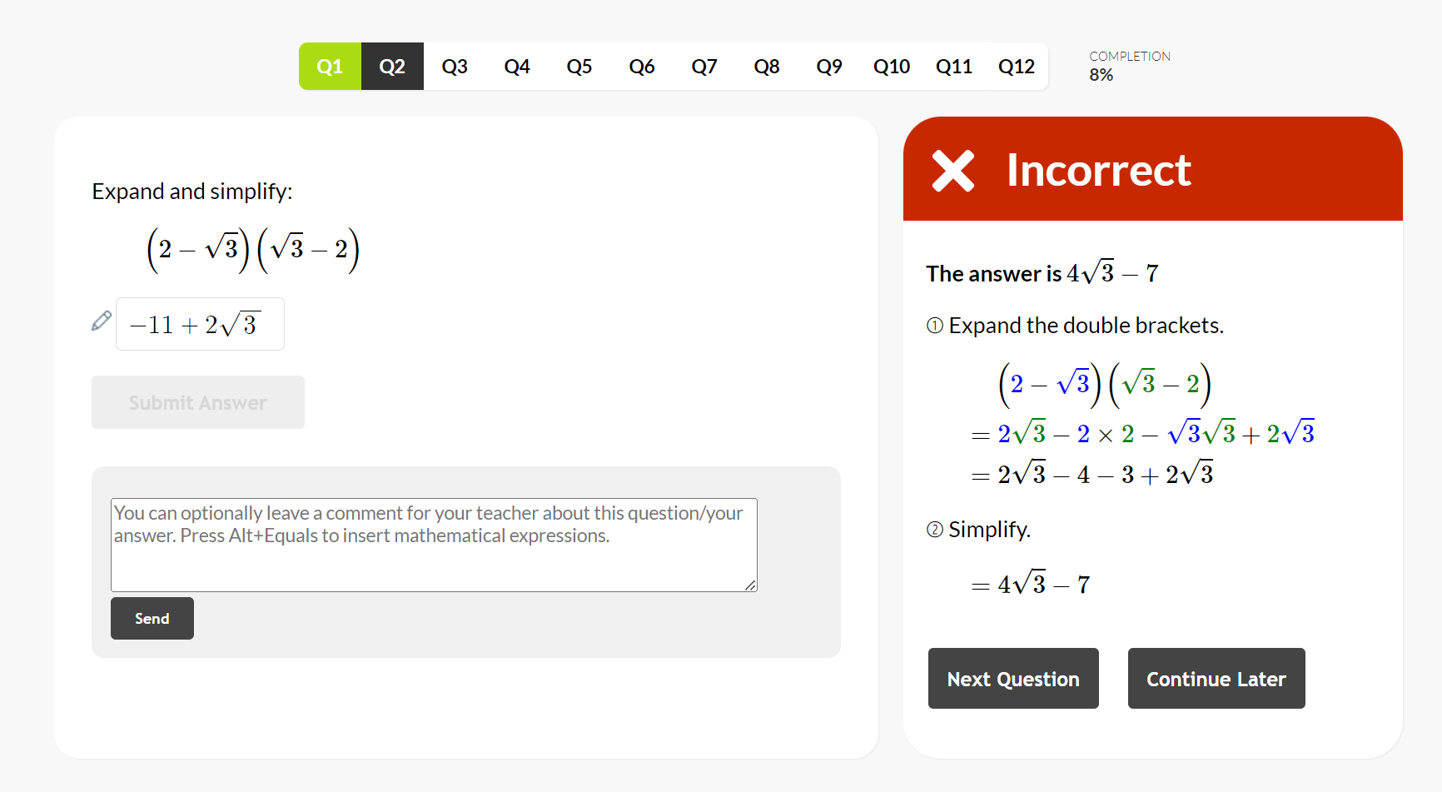
Completing an assigned task
If your teacher only allows you one attempt at the task, you’ll be shown the solution for incorrect answers.
Top tip: Read the solution, write down the steps and use it to help you with future questions.

Slide 13
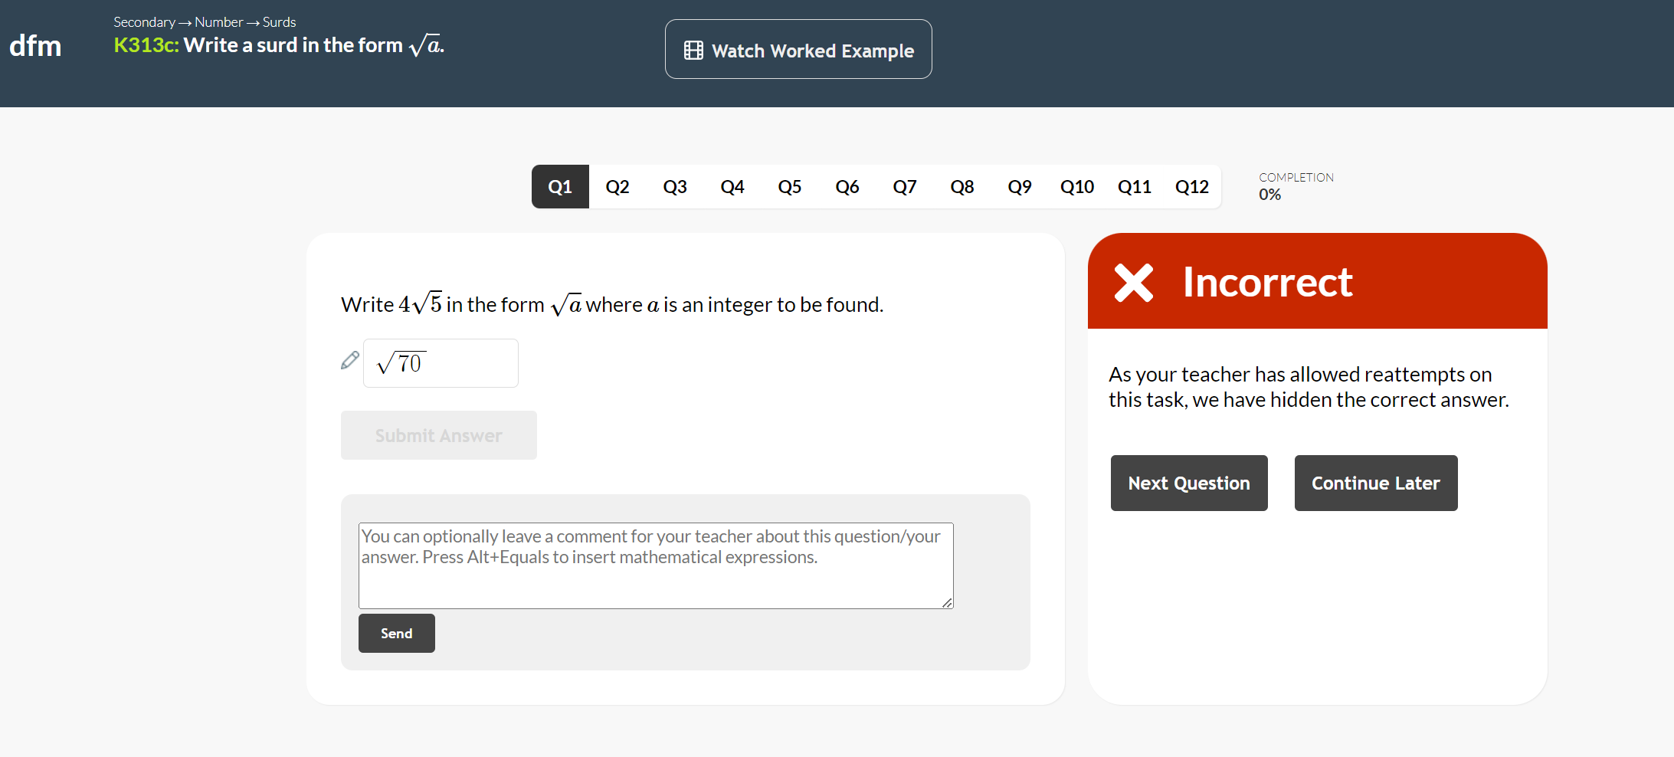
Completing an assigned task
If your teacher allows you to reattempt the task and if the task is a fixed set of questions (ie. Everyone in the class has the same set of questions) then you won’t be shown the solution.
This means you can reattempt the questions you got wrong and try for a better mark.

Slide 14
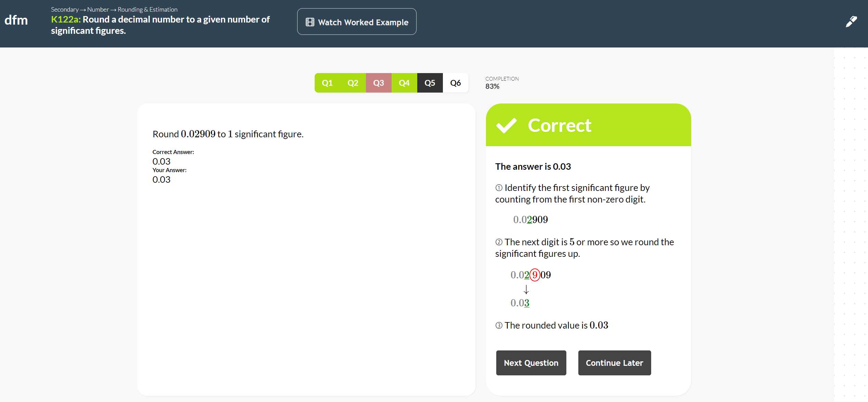
Completing an assigned task
You can press ‘Continue Later’ and come back to the task.
If the homework has a time limit then you will need to complete the task in one sitting, as the timer will continue to count down even if you close the task.

Slide 15
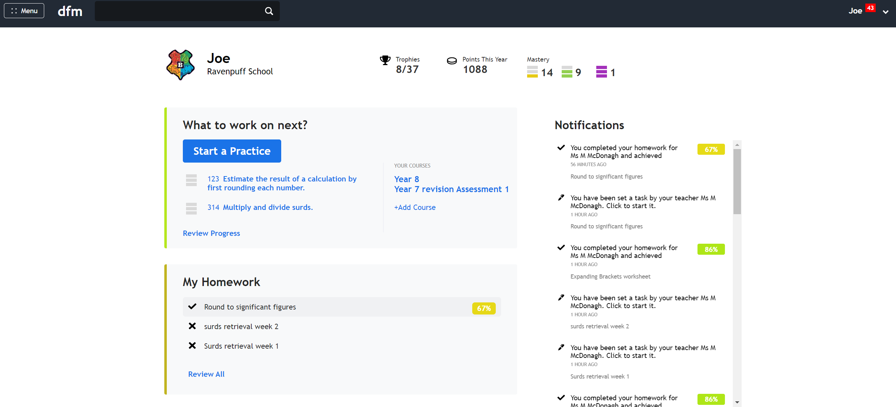
Completing as assigned task
If you press ‘Continue Later’ simply go to the home dashboard and click on the homework again.

Slide 16
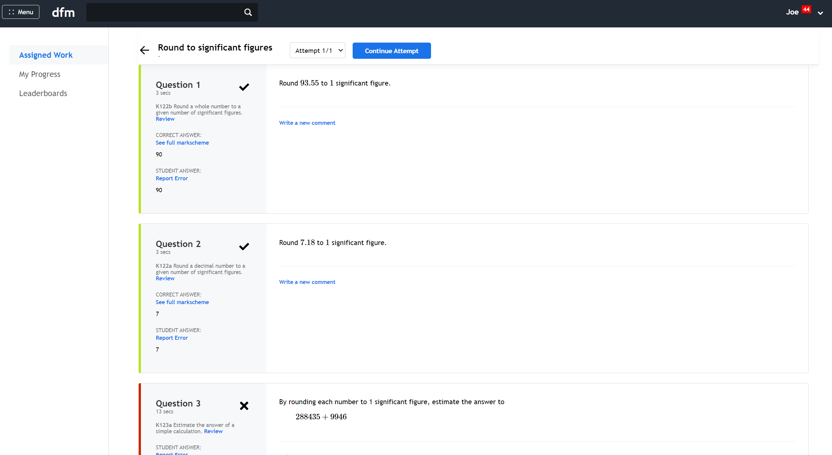
Completing an assigned task
Press ‘Continue Attempt’.

Slide 17
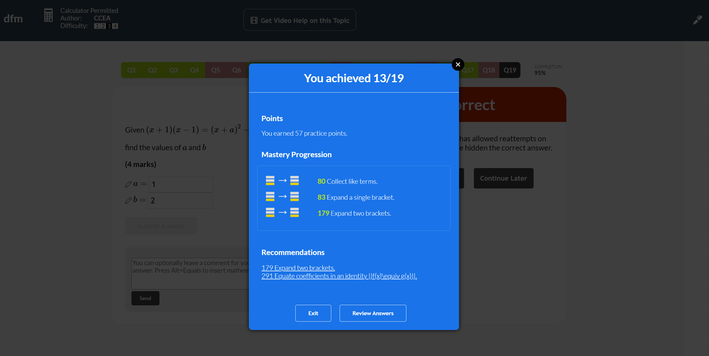
Completing an assigned task
At the end of the task you will have earned practice points and your mastery progression with the skills in the task will be recorded. You can press ‘Review Answers’ to write feedback comments and to reattempt the task for a better mark.

Slide 18
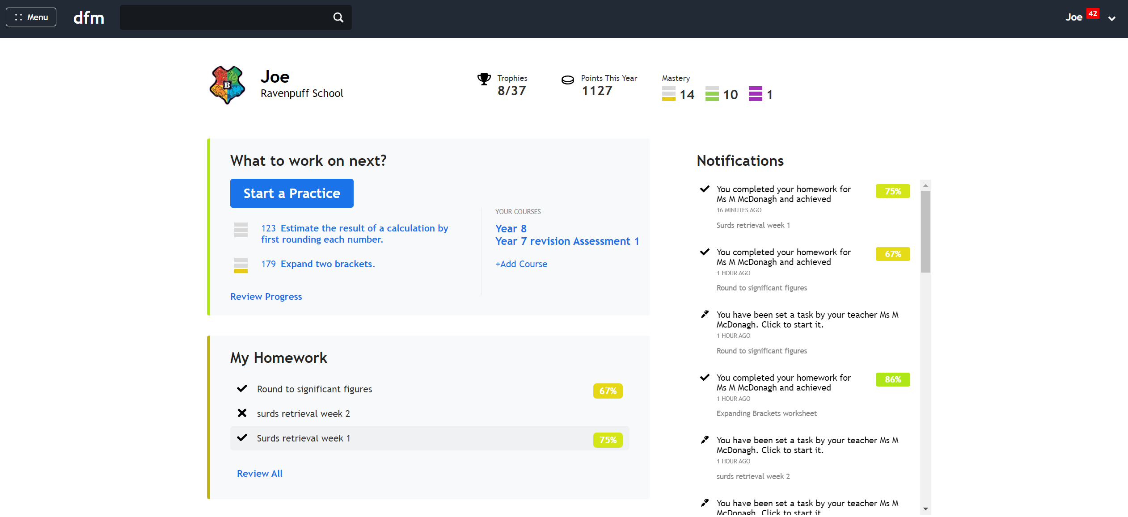
Reviewing a task
Click on a completed task with a tick icon to review your answers or click ‘Review All’.

Slide 19
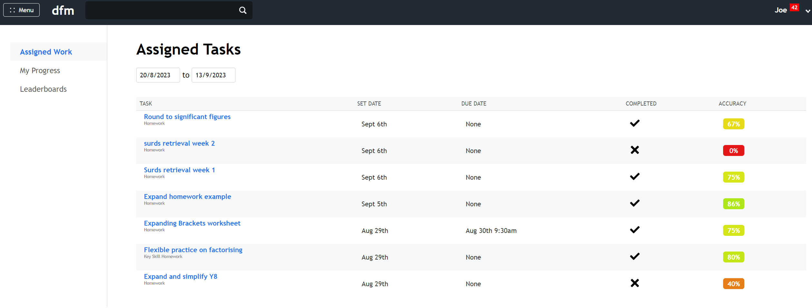
Reviewing a task
Click on a task to review your answers
Top Tip: If you have missed the deadline for a homework, you should click ‘Review All’ so that you can older tasks that no longer appear on the dashboard. You can click on the task to start the homework.

Slide 20
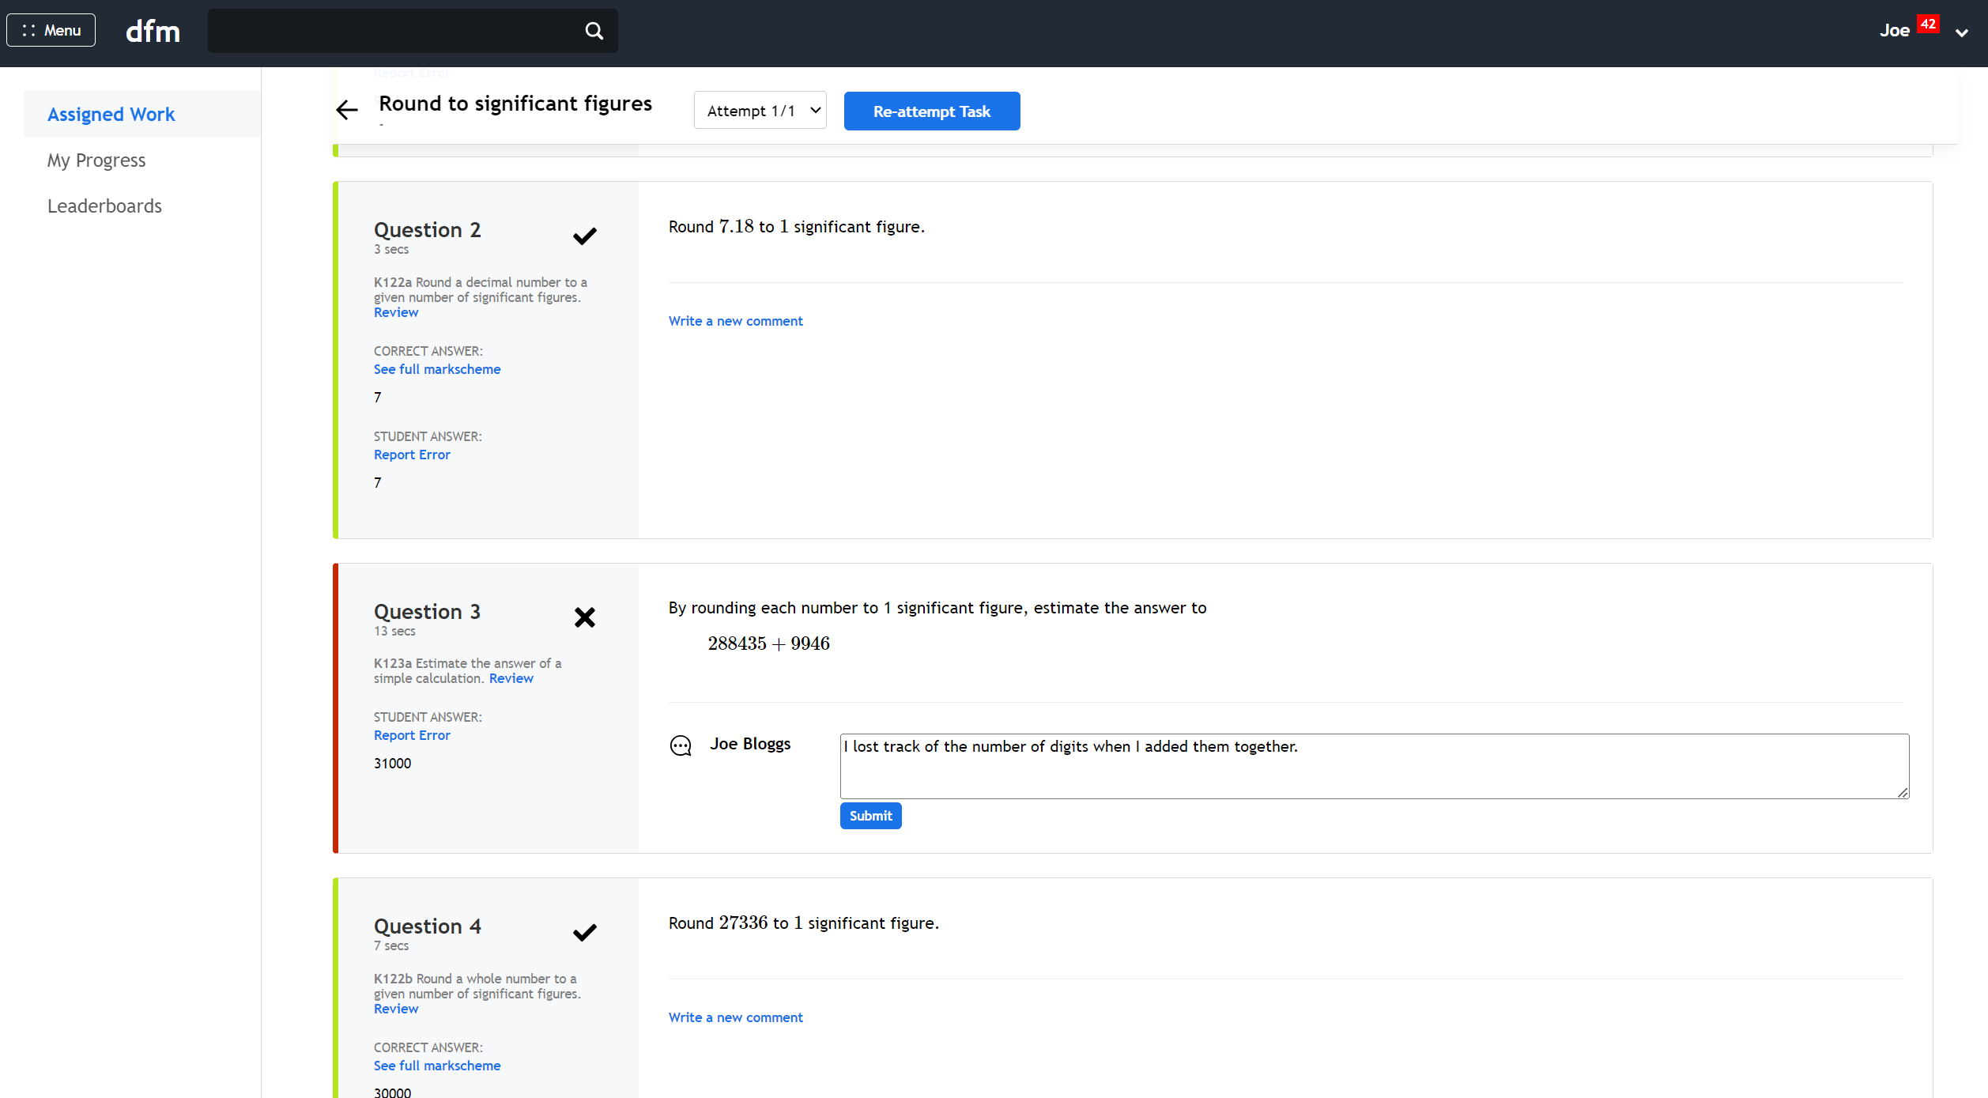
Reviewing a task
Click to re-attempt the task if this option is available.
Write a feedback comment to your teacher.

Slide 21
Reviewing a task
Click ‘Review’ to try more questions on the same Key Skill. You will be taken to the Skill Explorer where you can choose this skill to practise. E.g the code for this Key Skill is K123a.

Slide 22
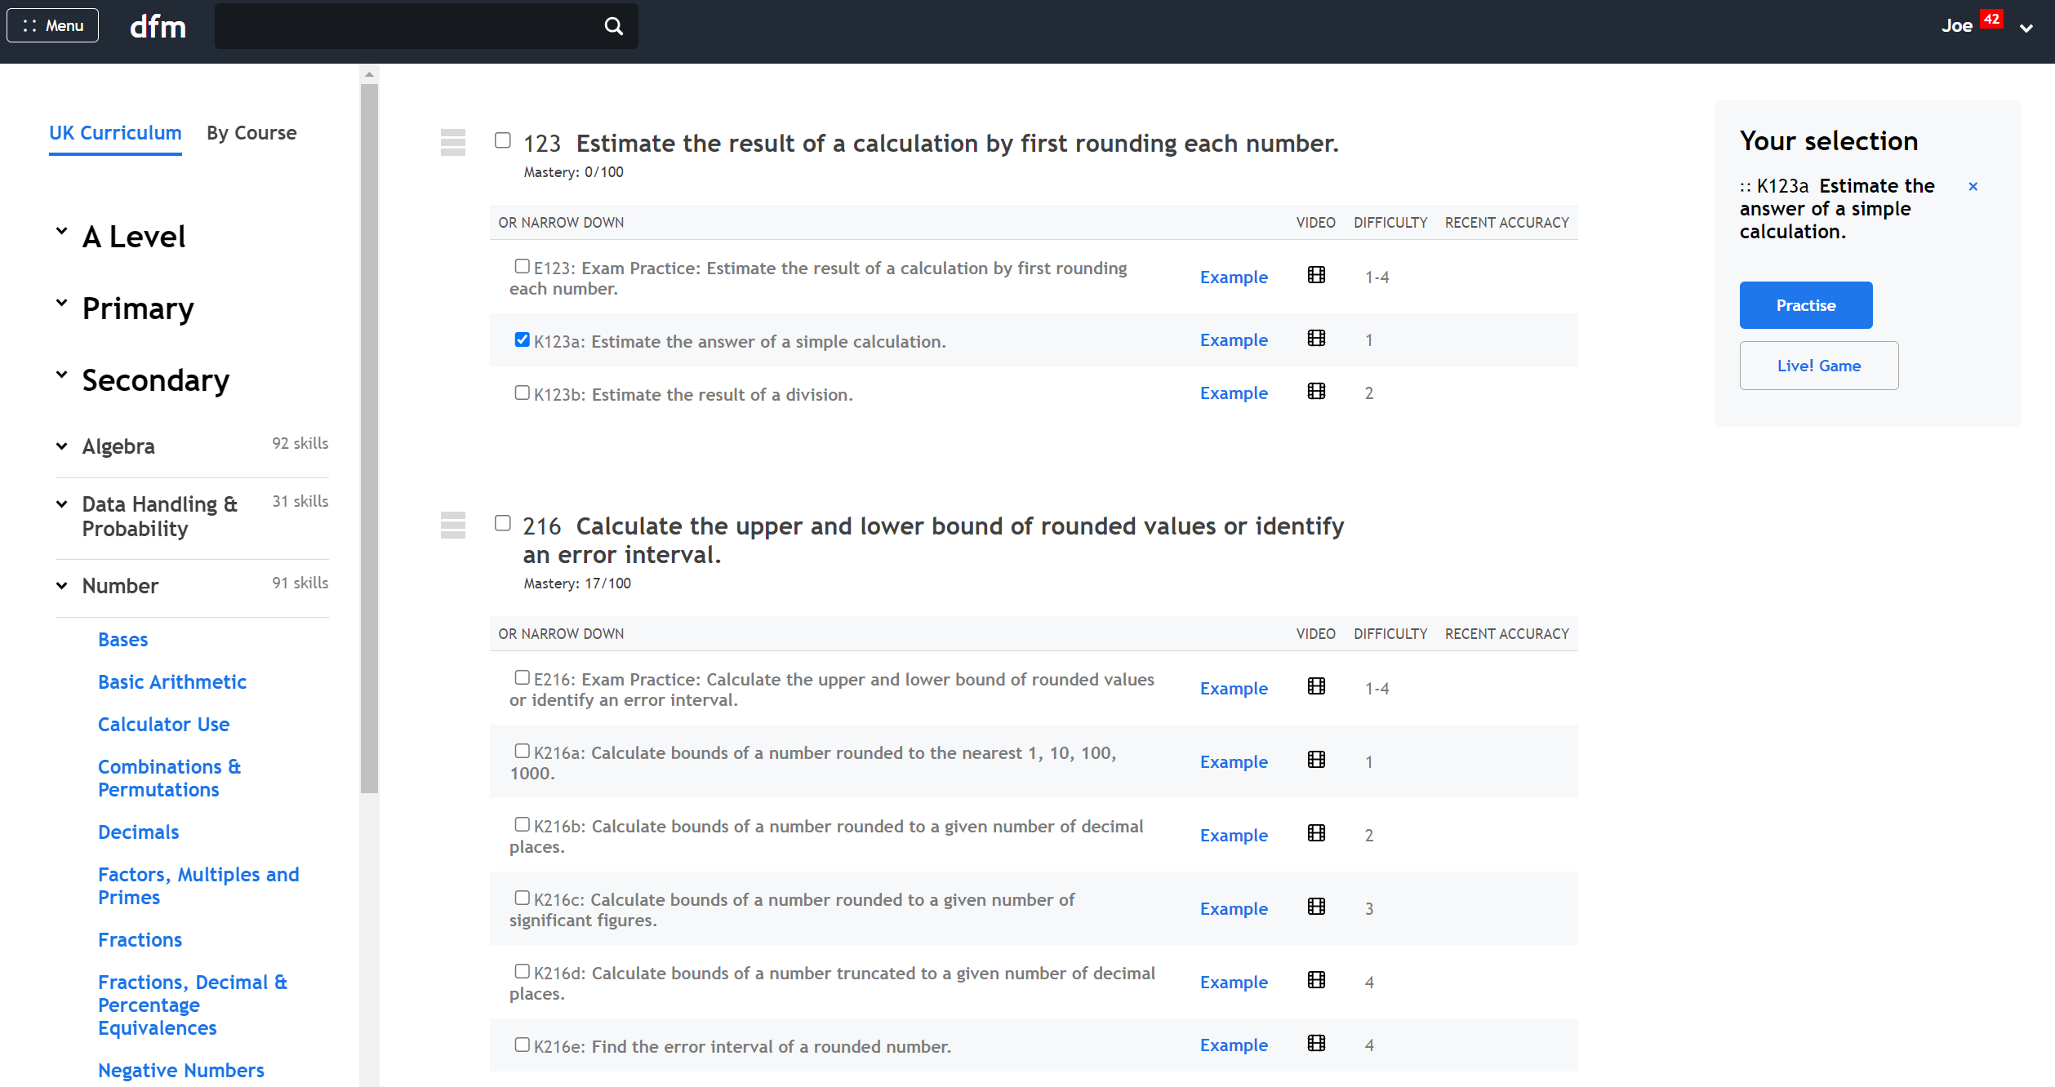
Reviewing a task
Select the code for the Key Skill you want to practise, e.g. K123a.
Press ‘Practise’.

Slide 23
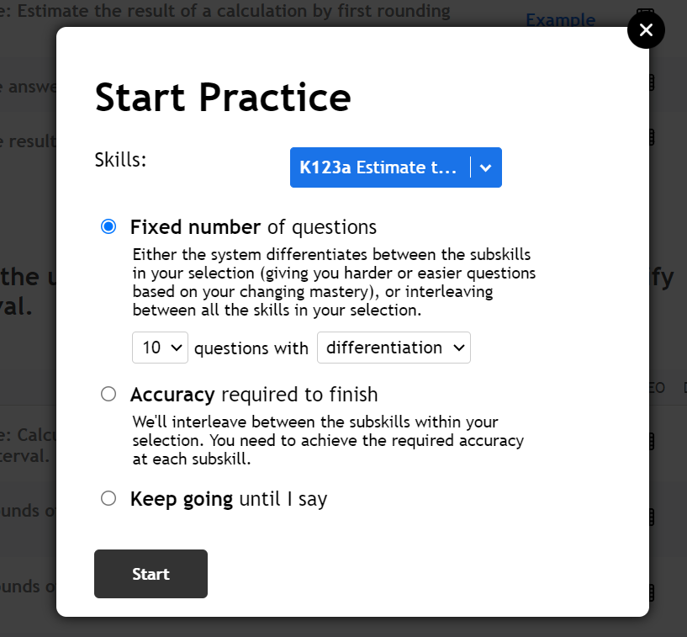
Reviewing the task
Choose whether to do a certain number of questions or whether to get aim for a level of accuracy and then press ‘Start’.

Slide 24
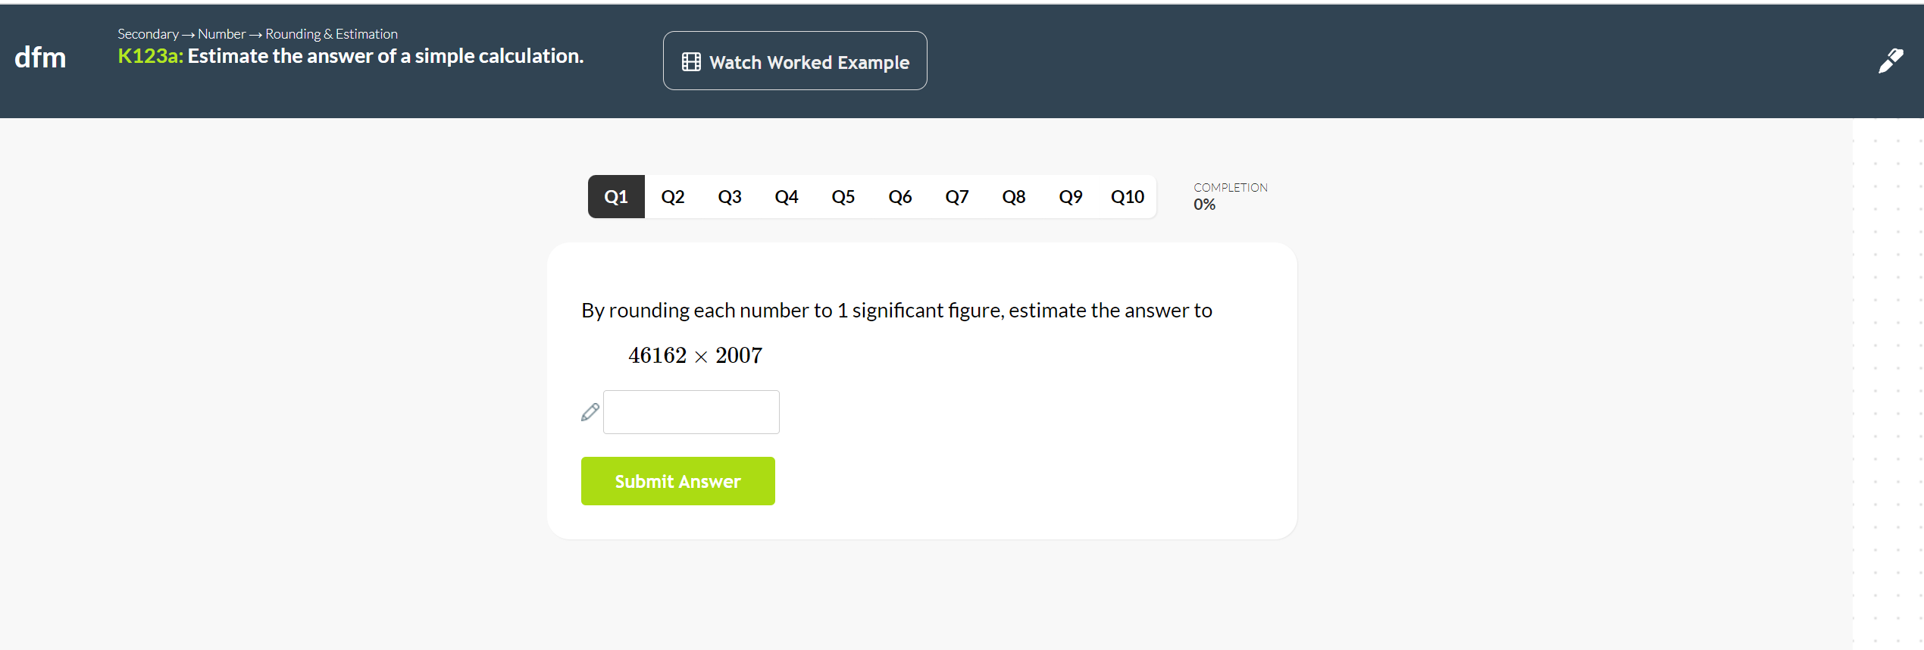
Reviewing a task
You will now be given a new set of questions on the Key Skill you struggled with on the homework. Remember, you will still have access to video help and you can improve your mastery on the skill by attempting more questions!

Slide 25
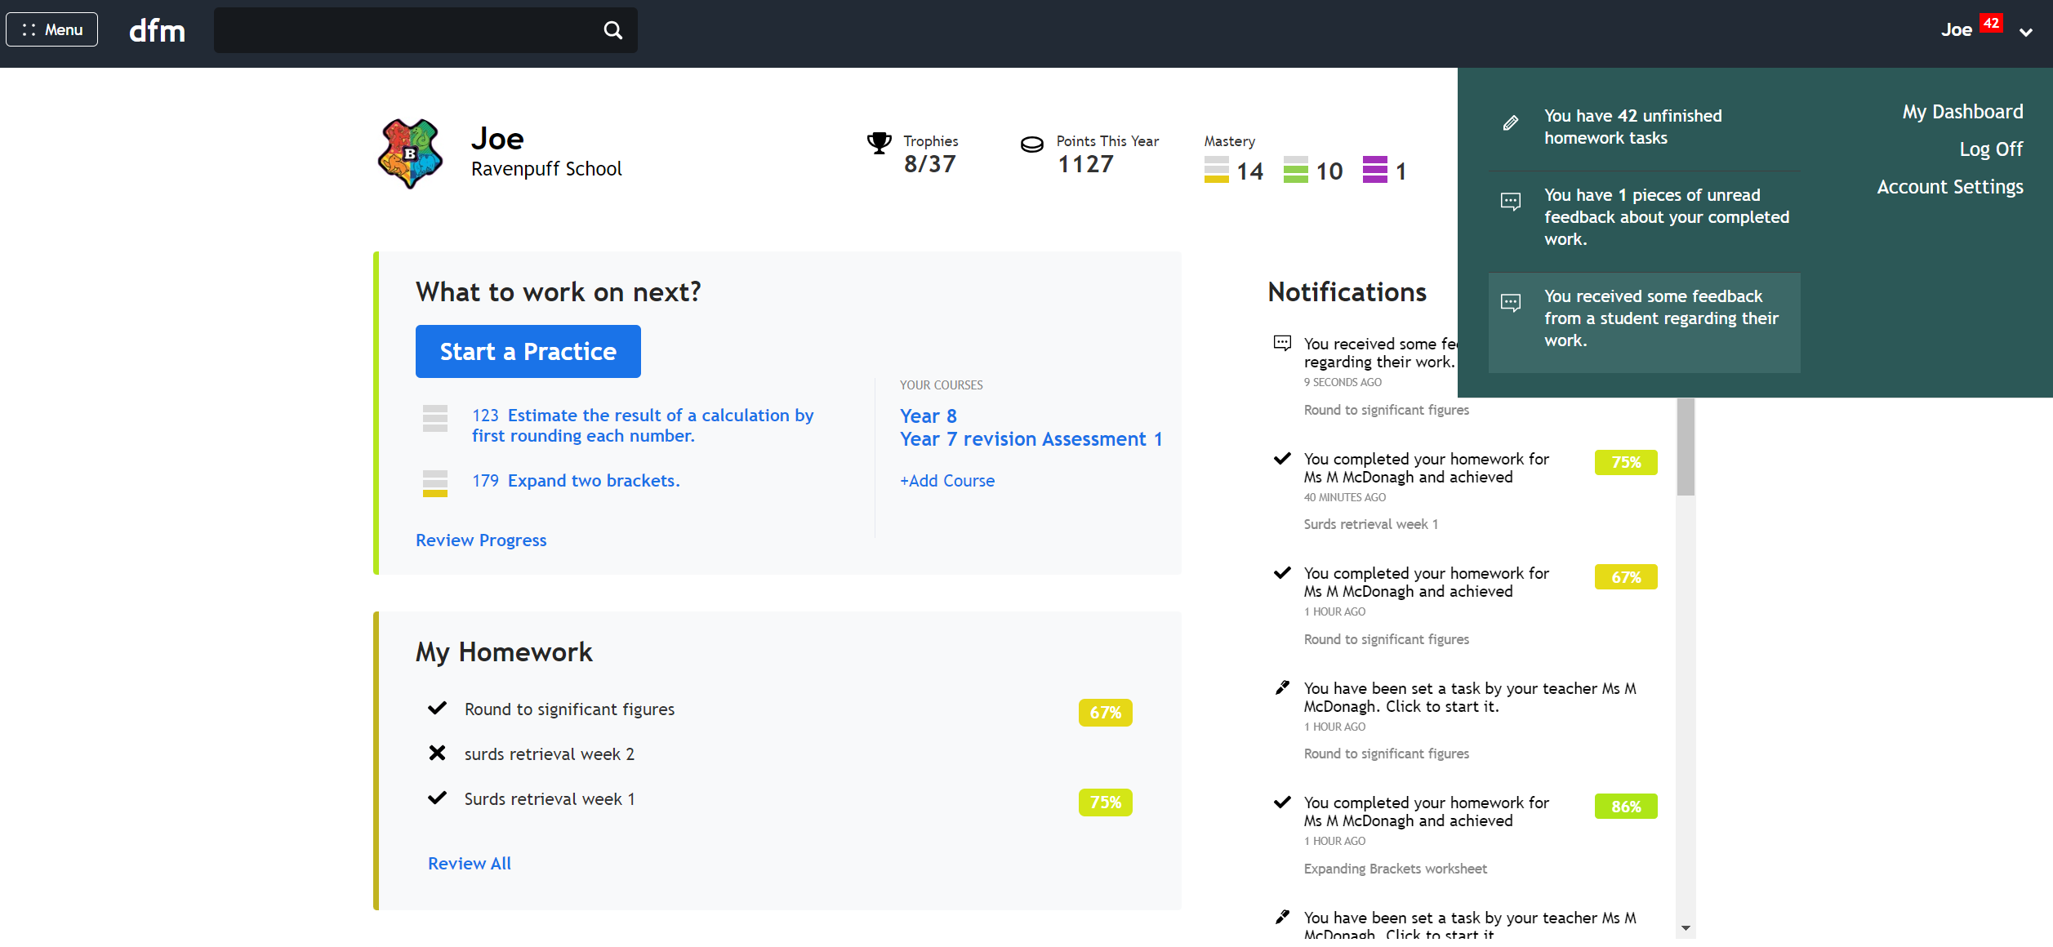
Responding to feedback
The red notifications next to your name will tell you if your teacher has left you feedback on a task. Click the notification to read and respond to the comment.

Slide 26
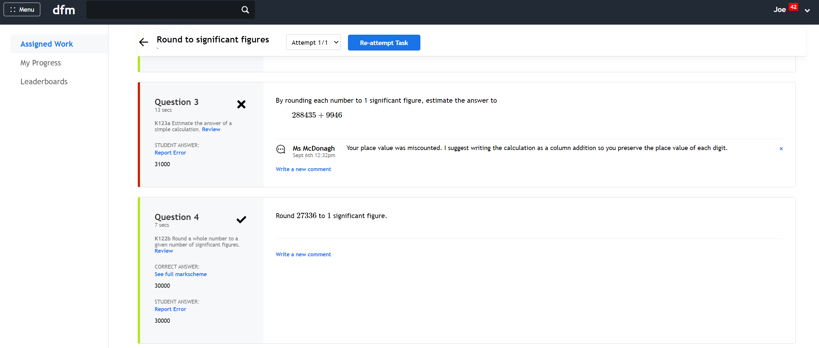
Responding to feedback
You can press ‘Write a new comment’ to respond.

Slide 27
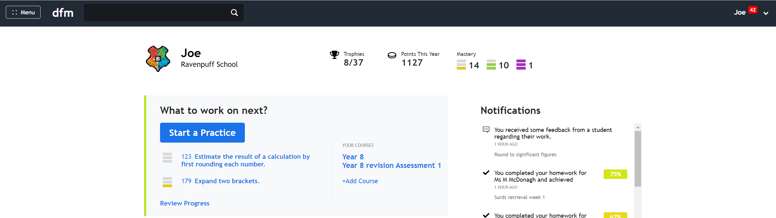
Independent practice
Press ‘Start a Practice’ to find a skill to practice.
Or click on a recommended skill based on your recent activity.

Slide 28
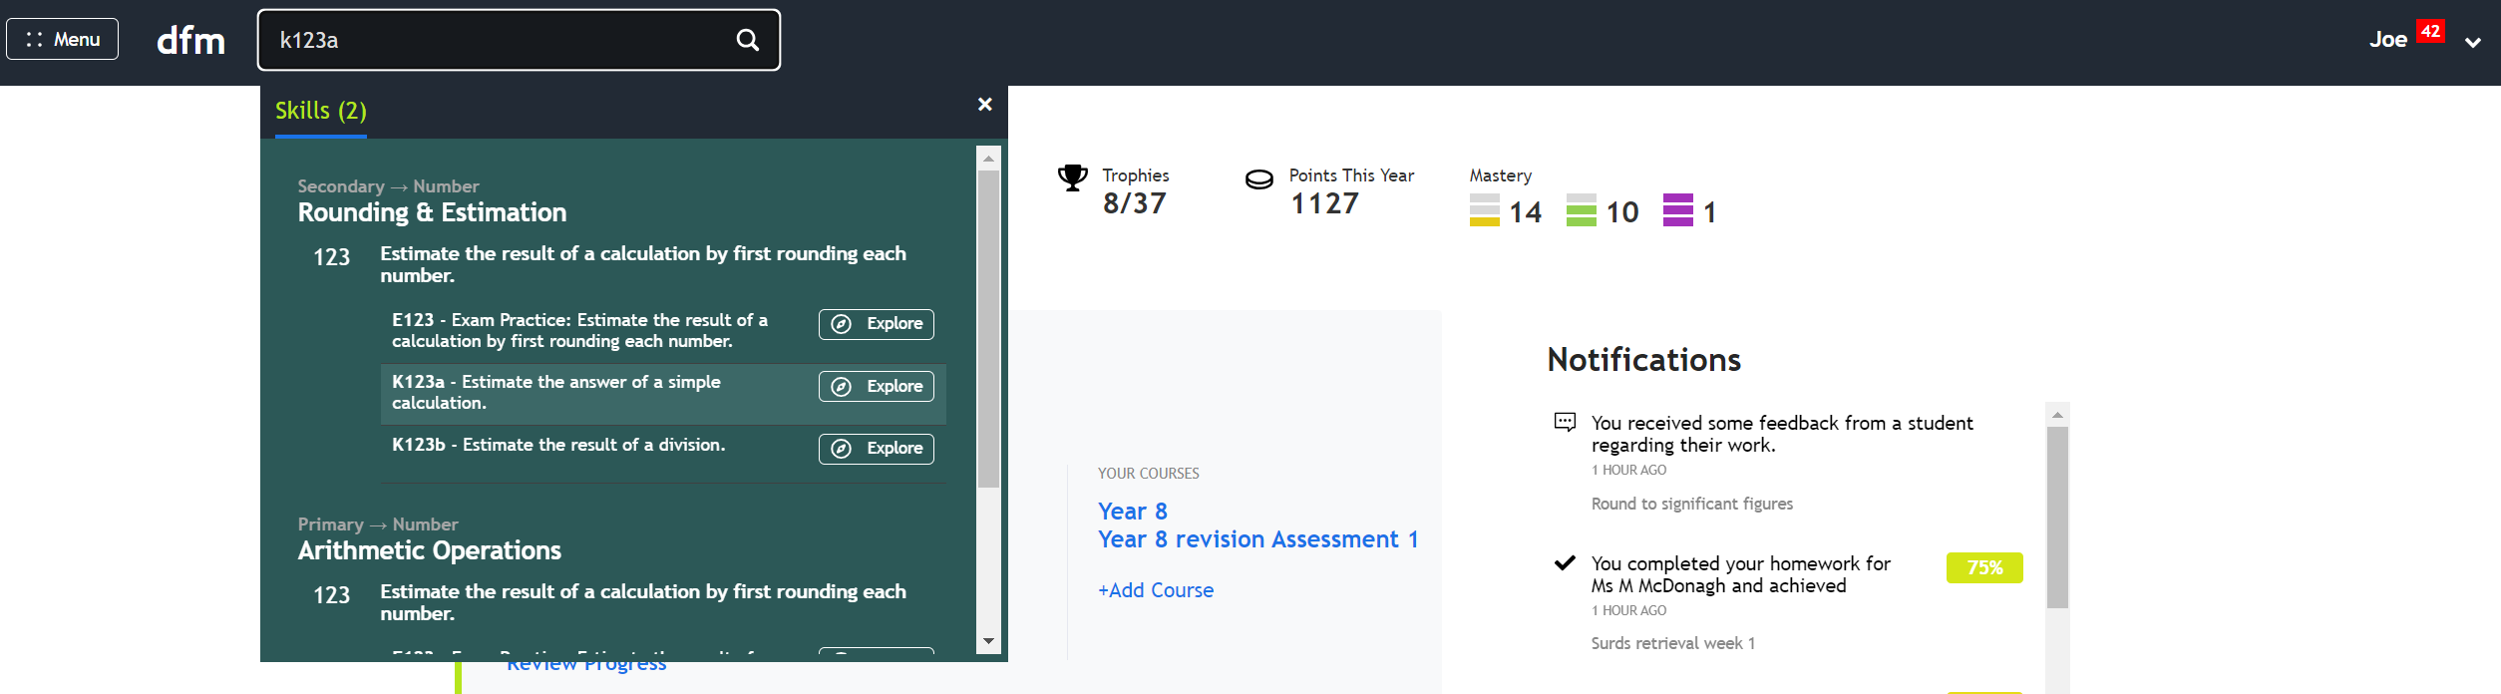
Independent practice
You can also type the name of the skill or the code into the search bar. This is often the easiest way to find practice questions – especially if your teacher has shared the codes with you!

Slide 29
Independent Practice
Select the code for the Key Skill you want to practise, e.g. K123a.
Press ‘Practise’.

Slide 30
Independent practice
Your teacher may assign you to one (or more) courses. E.g the ‘Year 8’ course outlines the topics you are learning this year and in the correct order. You can browse skills within the course and practise extra questions based on what you’re currently learning.

Slide 31
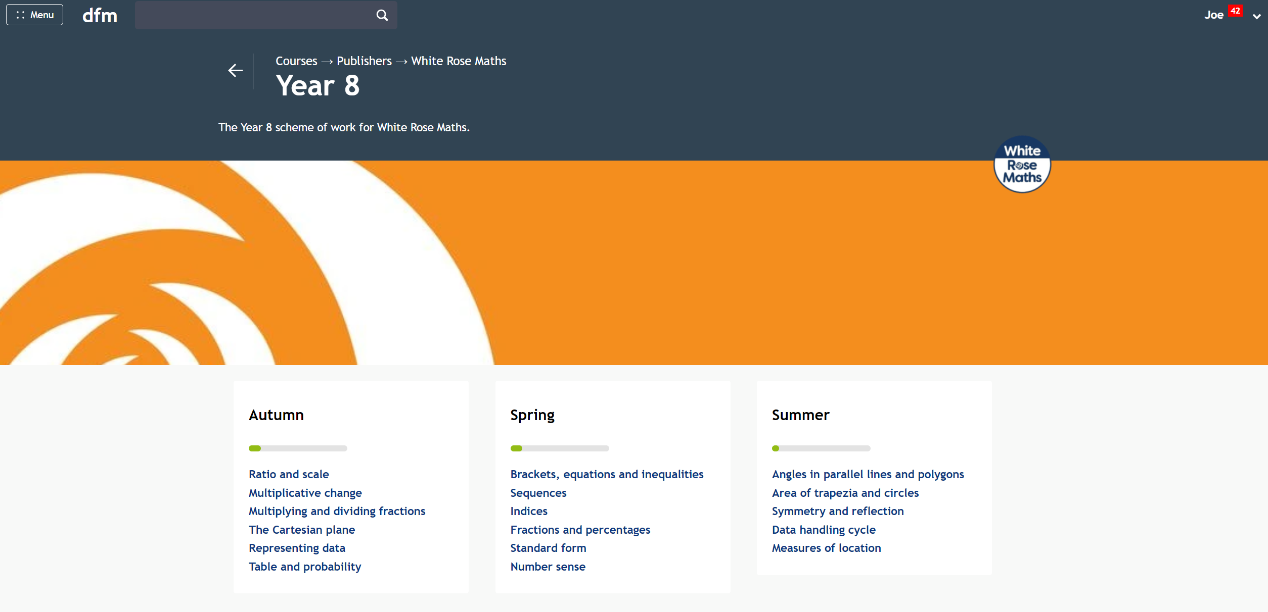
Independent practice
Simply choose the topic you are currently studying (or have already studied).

Slide 32
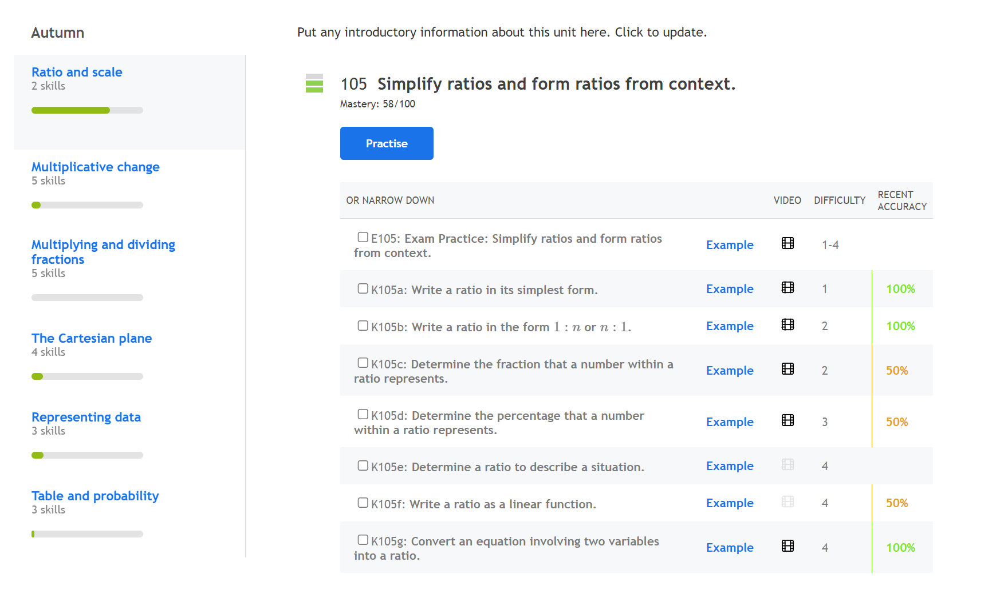
Independent practise
Click on the video icons for worked examples.

Slide 33
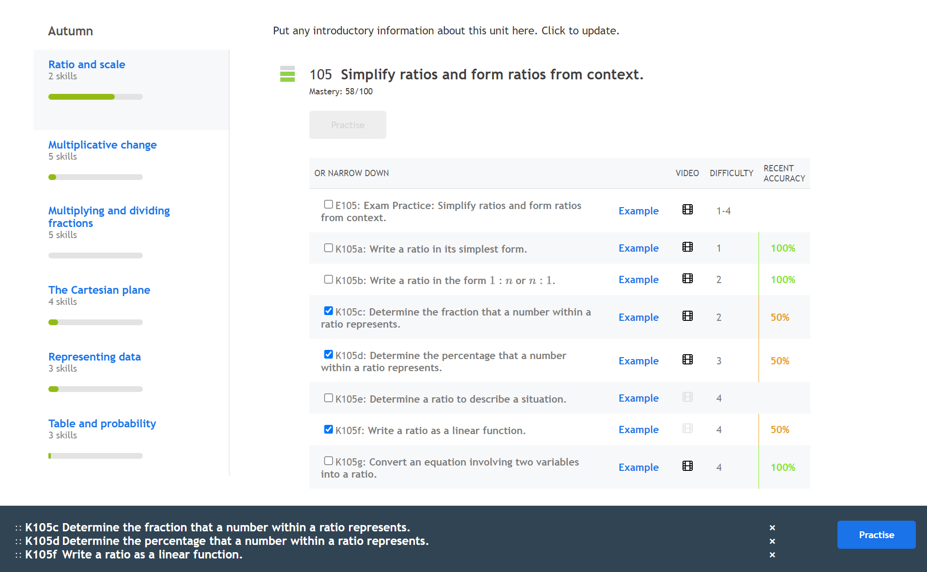
Independent practise
Select Key Skills you want to practise further (look at the recent accuracy as a guide).

Slide 34
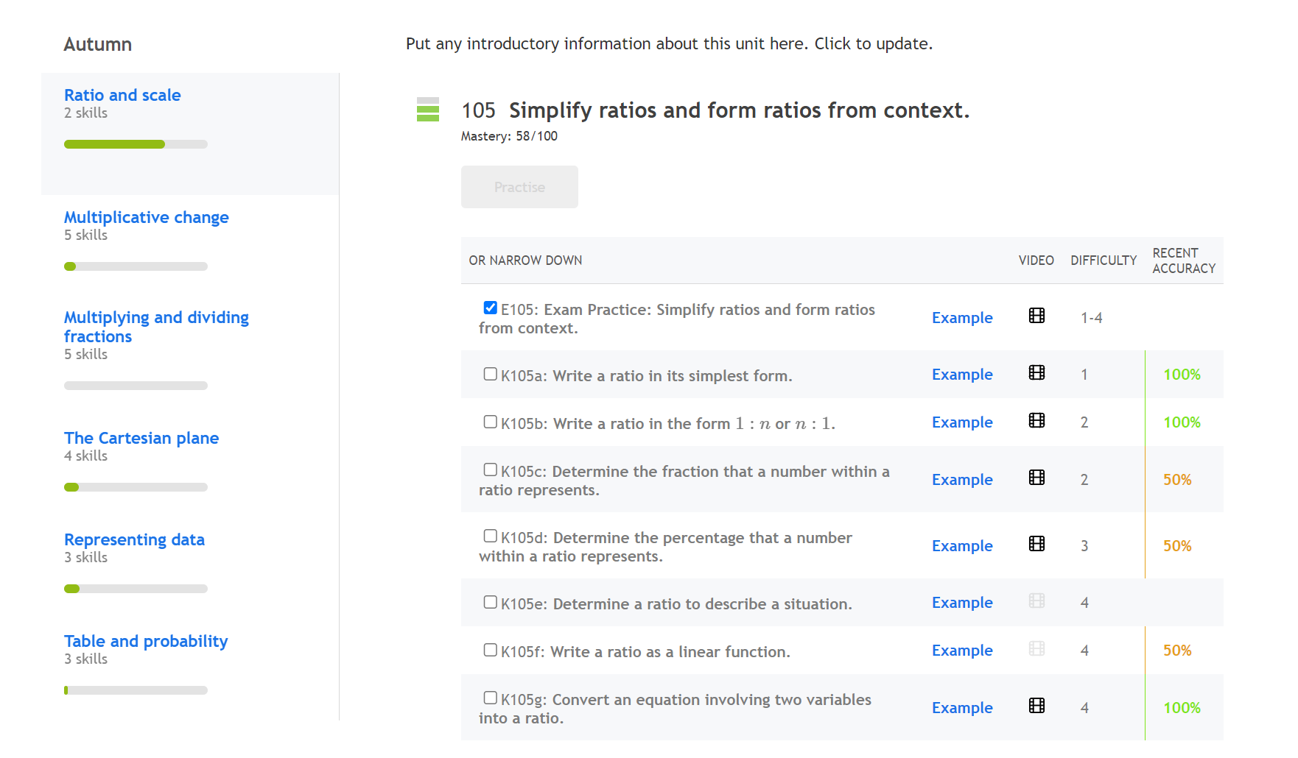
Independent practise
Or select Exam Practice (which is always at the top).

Slide 35
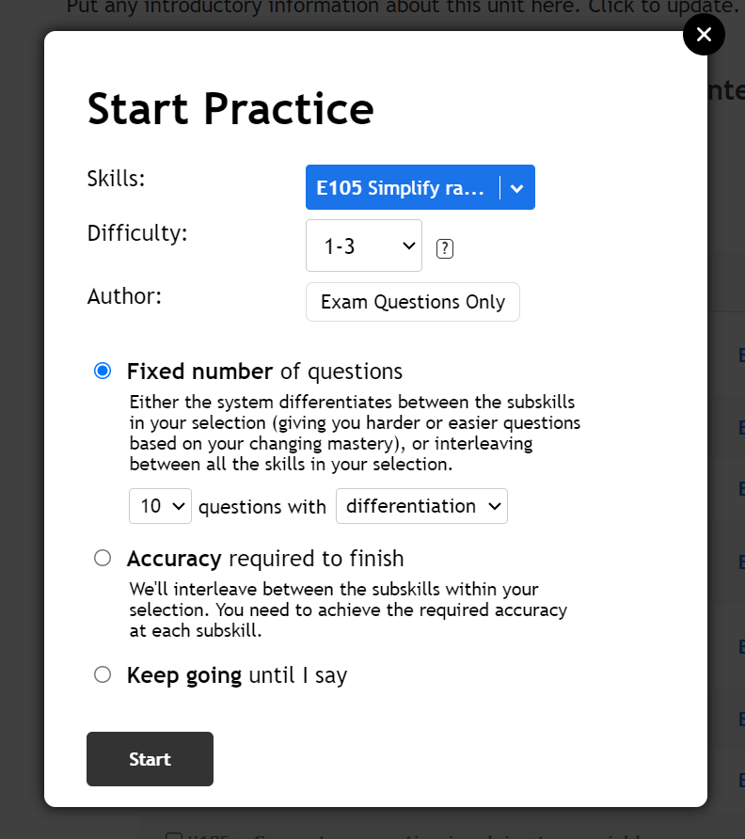
Independent practise
If you choose Exam Practise, you can change the difficulty of the questions and select your exam board (e.g. Edexcel, SQA, etc.)

Slide 36
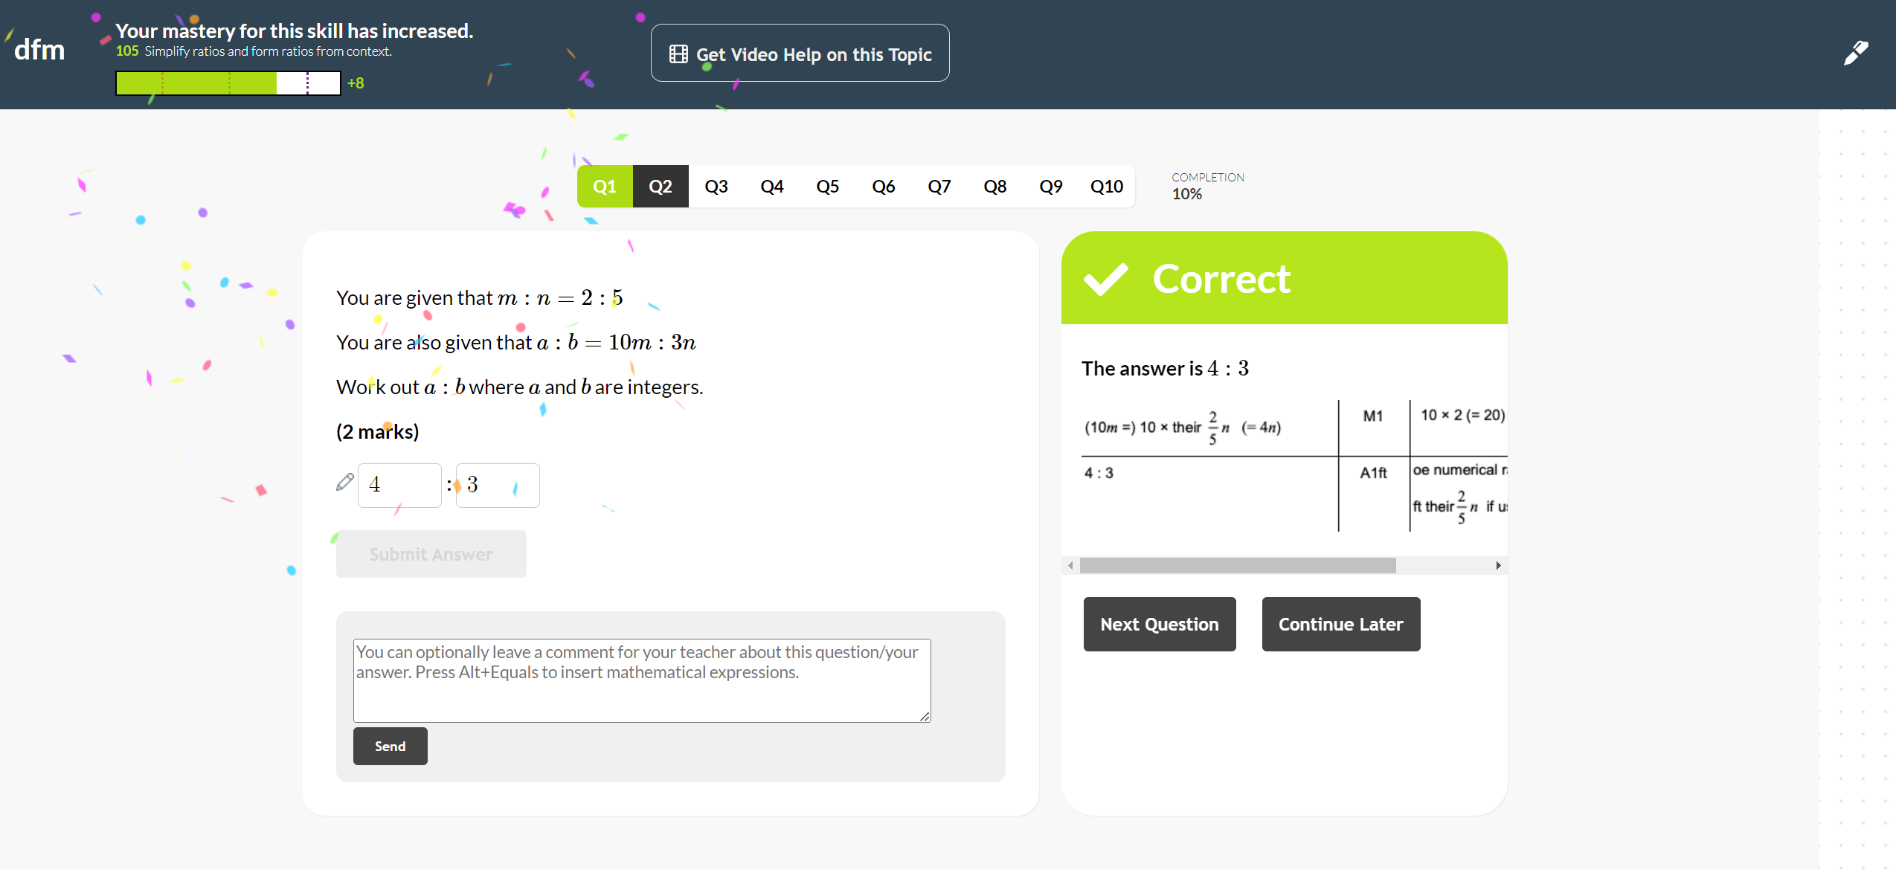
Independent practice
Answer questions in the usual way, watch video help and leave feedback for your teacher. Your teacher will be able to see the questions you have answered, even though you have not been set a task.

Slide 37
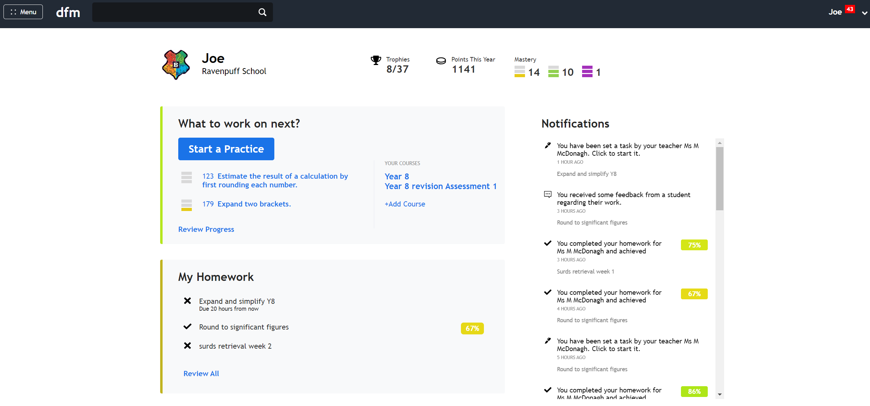
Independent practice
The ‘Start a Practice’ button also has some other review activities. Let’s explore these:

Slide 38
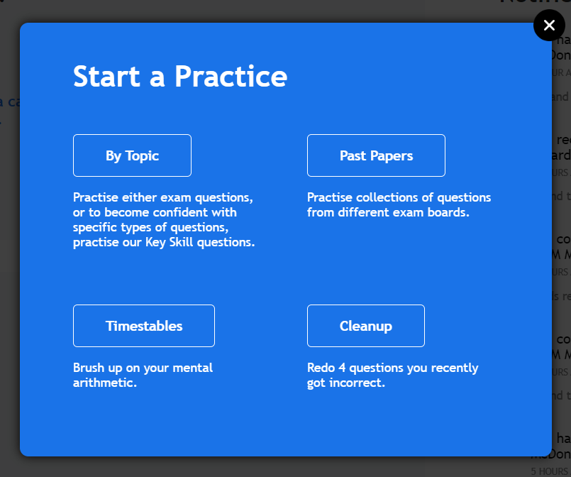
Independent practice
If you know the name of the skill you can search by topic for Key Skill and Exam practice.
Practice past papers online with immediate feedback if correct and review the mark scheme
Another chance to attempt questions you recently got wrong.
Practice makes perfect ☺

Slide 39
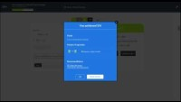
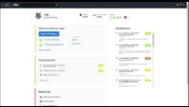
Help videos
How to complete and review an assigned task.
How to start an independent practice.

